Slide 1
Security framework and requirements for authorization and privilege lifecycle management of AI agents
Created at https://github.com/FG-TIDA/themes/issues/23
Ye Tao, Ying Wang
China Unicom

Slide 2
Background & Gap
Background:
AI agents are autonomous, networked software entities acting on behalf of users, services, or organizations. Their privileges are not static but follow a privilege lifecycle: created at initialization, adjusted as tasks evolve, suspended during hibernation, re-validated upon activation, and fully revoked at completion or termination.
Authorization & Privilege Lifecycle Management:
Authorization decides whether, when, and to what extent an agent may exercise privileges.
Privilege lifecycle management governs the states that privileges pass through.
The two are sequential and tightly coupled, operating within or across trust domains.
Gap:
Each privilege lifecycle phase and each authorization dimension introduces unique security challenges, and existing mechanisms do not yet provide a coherent, end-to-end approach to addressing them.

Slide 3
Issue
Issue Description:
Define an authorization framework and a set of security requirements for AI agents, so that they hold only the necessary privileges, exercise them at the necessary time in a controlled and auditable manner, and cover end-to-end security from authorization decisions to privilege granting, change, hibernation, activation, revocation, and recovery.
Expected Output:
  - An authorization framework covering the identified security dimensions.
  - Security requirements for each phase of the privilege lifecycle.
  - Cross-cutting governance requirements across all phases.
Notes:
Note: This Issue defines what must be satisfied, not how to implement it. Concrete technical solutions are out of scope.

Slide 4
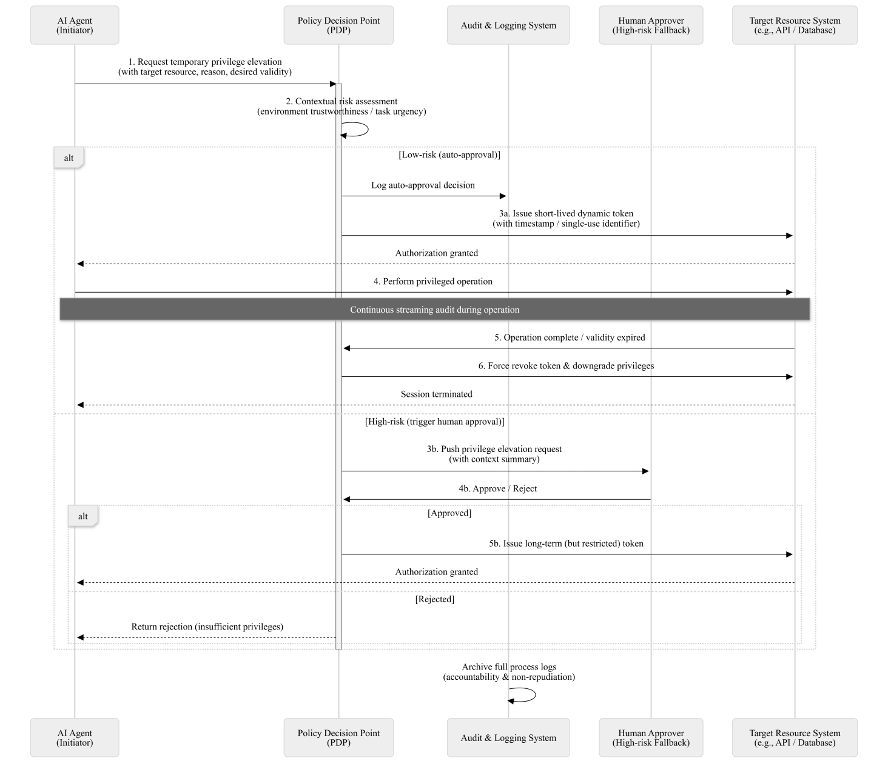
Figure 1. Sequential Diagram of the Authorization Process for AI Agents

Slide 5
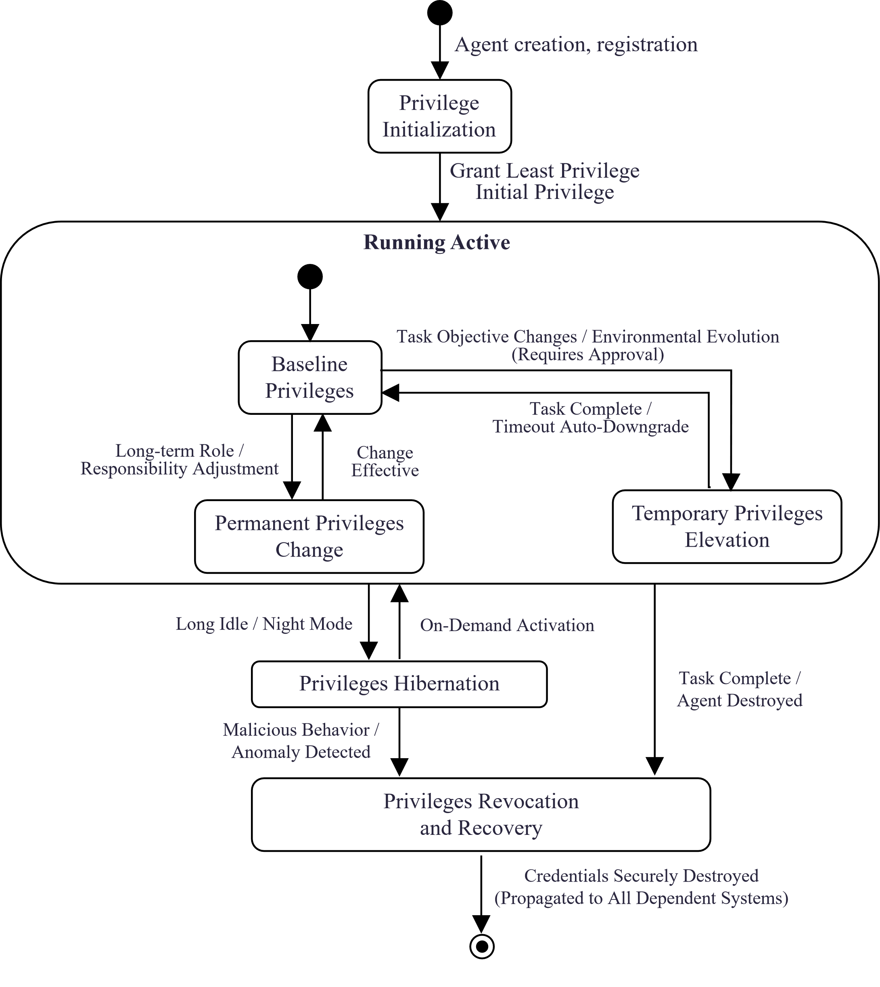
AI Agent Privilege Lifecycle Management
The privilege lifecycle describes the complete sequence of state transitions that a set of privileges undergoes during the lifetime of an AI agent. Five Key Lifecycle Phases:
Initialization – least-privilege assignment bound to verifiable identity
Change – real-time evaluation of any privilege modification
Hibernation – suspension and cryptographic isolation
Activation – mandatory re-assessment before restoration
Revocation & Recovery – irreversible revocation with cascading cleanup
Figure 2. AI Agent Privilege Lifecycle Model

Slide 6
Draft Scope
The draft specifies a security framework and security requirements for authorization and privilege lifecycle management of AI agents. In this framework, authorization enables AI agents to obtain the privileges they need under controlled and auditable conditions; privilege lifecycle management governs the full state transitions of those privileges from grant to revocation. This draft also identifies relevant security threats, and specifies the security requirements.
The scope of this draft includes:
Security threats for authorization of AI agents, and the corresponding security framework and security requirements;
Security threats for privilege lifecycle management (including initialization, change, hibernation, activation, revocation and recovery, and full-lifecycle governance) of AI agents, and the corresponding security requirements.
NOTE – The underlying authorization protocols and infrastructure such as OAuth, GNAP, X.1250-series IdM systems, are outside the scope.

Slide 7
Tkank you!

